Slide 1
Prevention and Control of Leptospirosis
Dr.W.I.U Jayawickrama
Senior Registrar (Community Medicine)

Slide 2
Introduction
Worldwide zoonotic infection
Emerging infectious disease
Greater incidence in tropical and subtropical regions
Often peaks seasonally, sometimes in outbreaks
Often linked to climate changes, poor urban slum communities, occupation or recreational activities

Slide 3
Introduction (Cont.)
Clinical course in humans: ranges from mild to lethal with a broad spectrum of symptoms and clinical signs (subclinical infection to multi-organ failure with high mortality)
Transmitted through mud or water contaminated by the urine of infected animals (rodents, livestock, domestic animals and wild mammals)

Slide 4
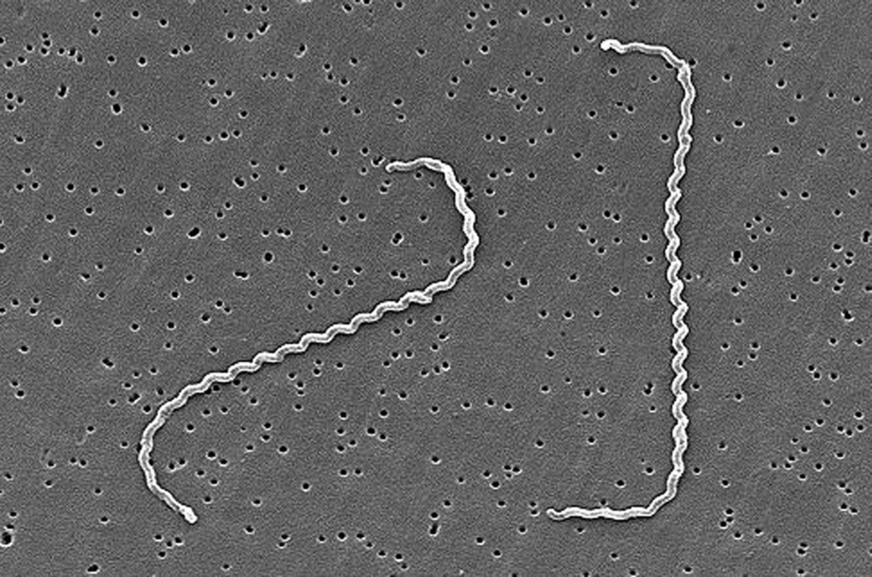
Causal agent and main modes of transmission
Causal agent: Pathogenic Leptospires, belong to the genus Leptospira (Long corkscrew-shaped bacteria)

Slide 5
Main modes of transmission: Feral and domestic animals constitute the reservoir of the agent,
transmitted through contact of mucous membranes or (broken) skin with water (swimming or immersion), moist soil or vegetation contaminated with the urine of infected animals
Occasional infection through ingestion/inhalation of food, droplet aerosols of fluids contaminated by urine

Slide 6
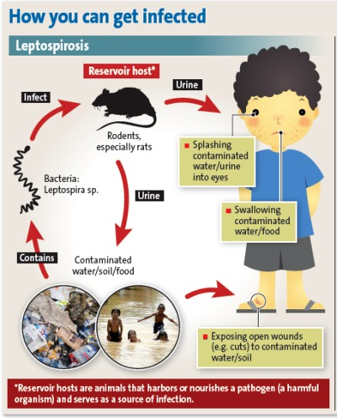
Source:
http://wiki.ggc.edu/wiki/Leptospirosis_Fall_%2713

Slide 7
Incubation period usually 5-14 days, with a range of 2-30 days
Most infections –asymptomatic or mimic mild flu like illness –unnoticed
Small number of cases- severe form of illness with multi-organ failure

Slide 8
Clinical presentation
Initial Bacteraemic phase
Leptospira proliferate and disseminate throughout the body
Immune phase
Leptospira are cleared but the tissue damage continues with fever and other constitutional symptoms
With an acute onset of fever with chills and rigours, headache, myalgia, nausea, vomiting and conjunctival suffusion
Development of oliguria, jaundice, meningism, haemorrhage, shock, pulmonary involvement and myocarditis

Slide 9
Diagnosis of leptospirosis
Knowledge of local epidemiology, varied clinical presentation and high index of suspicion (history of occupational and recreational exposure) are essential to make a diagnosis
Confirmatory diagnosis: detecting antibodies e.g. Microscopic Agglutination Test (MAT)
PCR test and culture
Simple Investigations: UFR (albumin +) / FBC (polymorpholeucocytosis)
Identifying serovars (serotyping) – costly, time consuming, not affecting the treatment

Slide 10
Treatment of leptospirosis
Potentially serious but treatable disease
Treatment with effective antibiotics –initiate as soon as the disease is suspected
Should not wait for the investigation results, serological test becomes positive about a week after the onset of disease, culture takes weeks to become positive
Supportive care with strict attention to fluid and electrolyte balance
Dialysis is indicated in renal failure

Slide 11
Epidemiology
First confirmed leptospirosis case in 1953 in Sri Lanka
Significant increase in reporting and identifying cases over last few decades
Largest outbreak of leptospirosis in 2008 with 7423 suspected cases and 204 deaths

Slide 12
Epidemiology (Cases reported in 2018)
Month | No. of cases
January | 365
February | 206
March | 367
April | 356
May | 378
June | 444
July | 463
August | 349
September | 337
October | 356
November | 958
December | 677
TOTAL | 5256

Slide 13
Epidemiology
Leptospirosis is endemic in Sri Lanka with occasional outbreaks
Highly endemic areas are Colombo, Gampaha, Matale, Kurunegala and Kalutara
Overcrowded with agricultural communities
Changing weather and environmental factors
Two peaks in disease incidence: smaller one during March-May and larger one during October- December

Slide 14
Epidemiology (district distribution in 2018)
RDHS | Total Cases
Colombo | 241
Gampaha | 233
Kalutara | 712
Kandy | 124
Matale | 119
Nuwara Eliya | 54
Galle | 436
Hambantota | 93
Matara | 292
Jaffna | 22
Kilinochchi | 13
Mannar | 1
Vavuniya | 52
Mulativu | 14
Batticaloa | 63
Ampara | 71
Trincomalee | 64
Kurunegala | 379
Puttalam | 59
Anuradhapura | 251
Polonnaruwa | 192
Badulla | 189
Moneragala | 422
Ratnapura | 777
Kegalle | 368
Kalmunai | 15
TOTAL | 5256

Slide 15
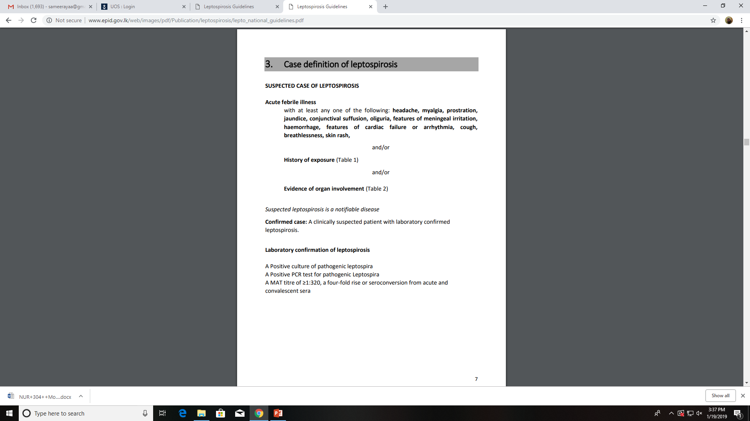
Surveillance of Leptospirosis

Slide 17
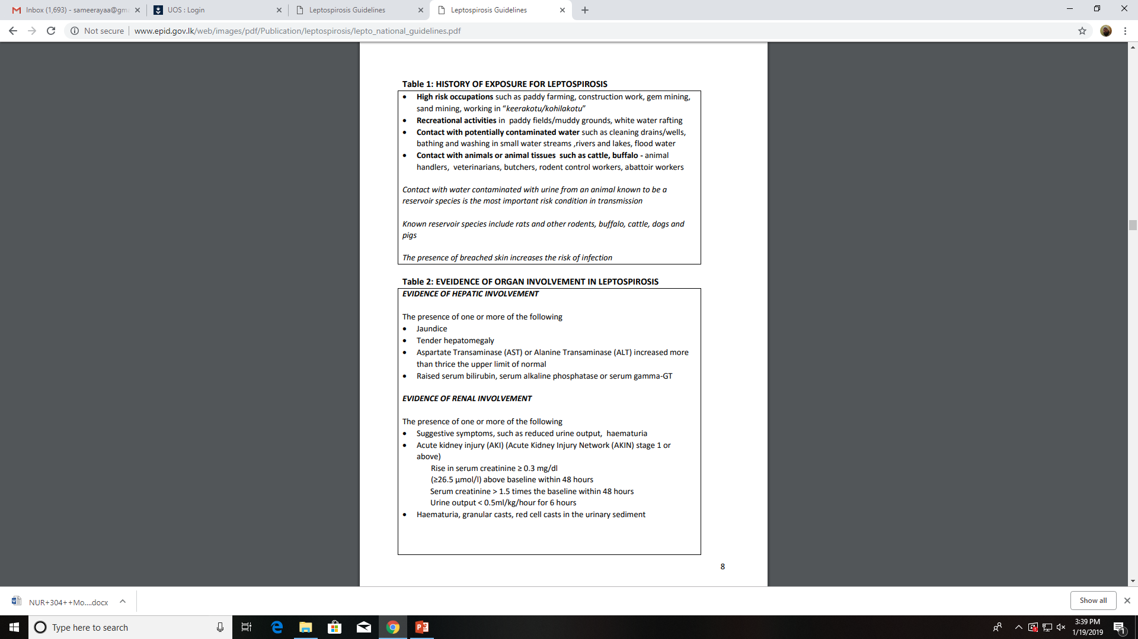

Slide 19
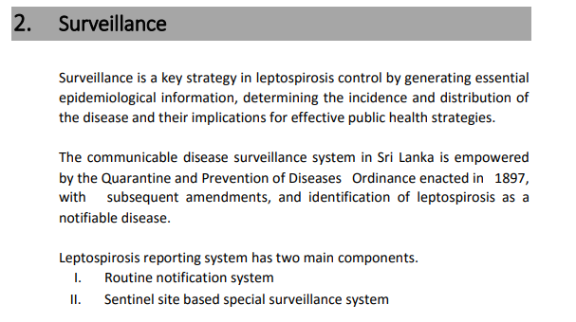

Slide 20
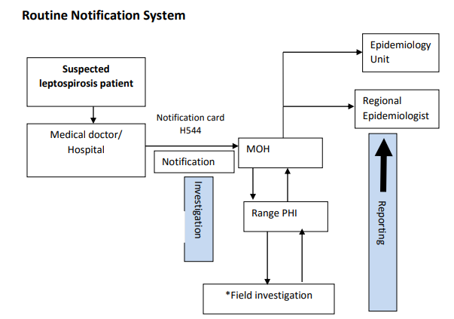

Slide 21
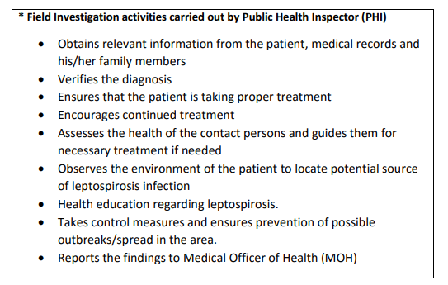

Slide 22


Slide 23
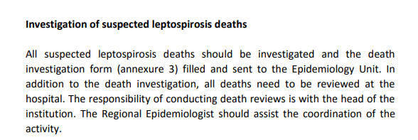

Slide 24
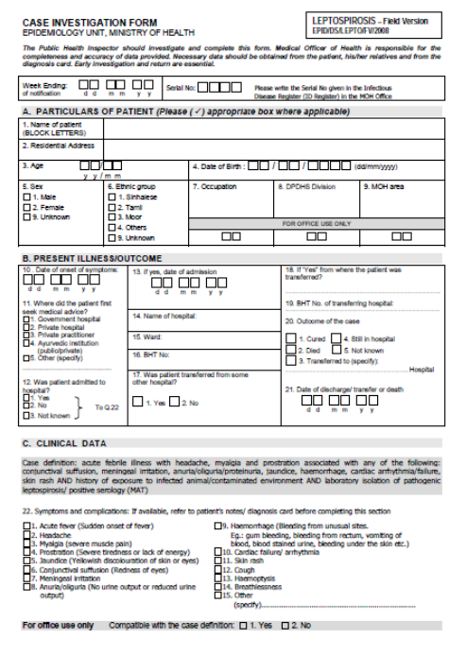

Slide 25
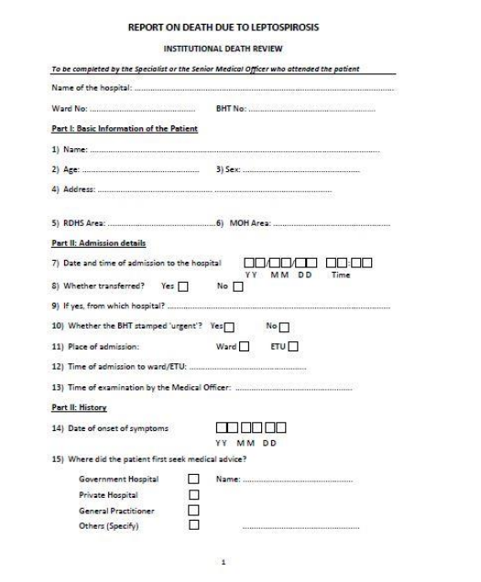

Slide 26
Prevention and control of leptospirosis
Primary Prevention
Knowledge, awareness and behaviour of people are key essential components
Increased awareness of the disease among high risk groups, health care providers and even among general public
early treatment seeking behaviour and early diagnosis

Slide 27
Environmental Measures
To prevent illness, prevent contamination of living, working and recreational areas by urine of infected animals
Control rodent populations in areas of human habitation
Domestic animal owners should take necessary precautions to minimize their animal’s potential
Avoid contact with wildlife (E.g., do not feed pets outside or allow animals to roam unsupervised)
Do not allow animals to urinate in or near ponds or pools

Slide 28
Removal of rubbish and keeping areas around human habitation clean to control rodents
Keep animals away from gardens, play grounds, sand boxes and other places where children play
Wear appropriate protective clothing, knee-high boots, gloves etc and wounds cover with waterproof dressing to high risk occupational groups
Use boiled water
Avoid walking in flood water

Slide 29
Chemo prophylaxis: Doxycycline can prevent leptospirosis, if given before and during exposure
Sri Lankan national programme of Leptospirosis focuses on both reduction of incidence as well as case fatality rate (CFR) of leptospirosis and outbreak prevention. Strengthening surveillance specially during paddy cultivation season and improving inter-sectoral coordination with other key sectors such as agriculture, irrigation and animal husbandry at MOH level.

Slide 30


